Slide 1


Slide 2
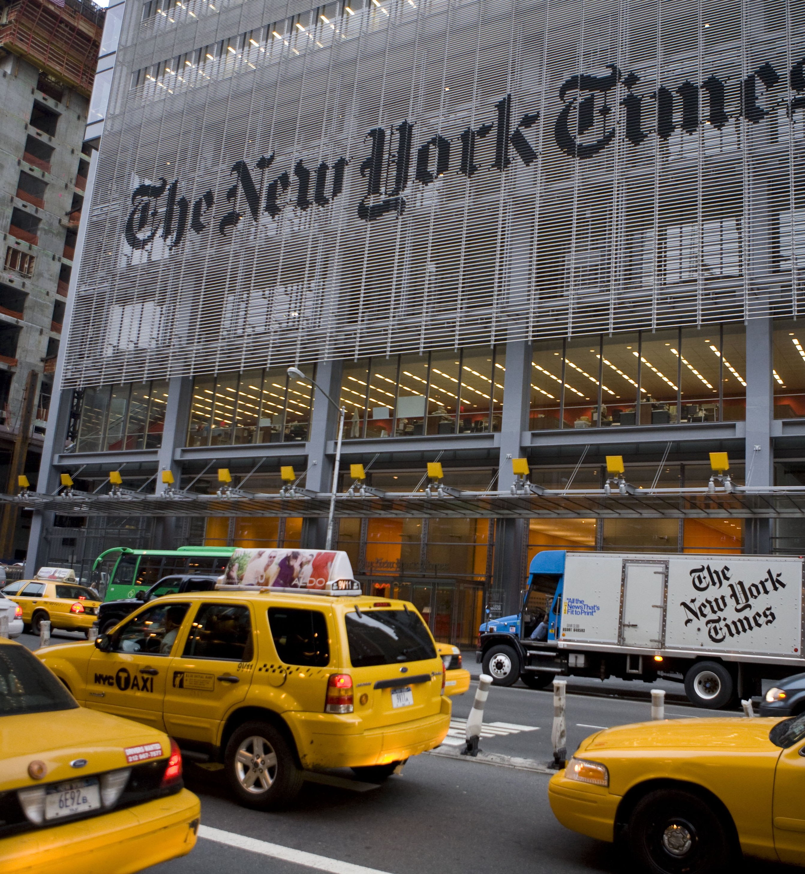
Introduction
American newspaper based in New-York city
Paper’s motto : "All the News That's Fit to Print“
Nickname : “The Gray Lady”
“The most respected newspaper in the world.” (WYNC, 2012)
Awards : 125 Pulitzer Prizes

Slide 3
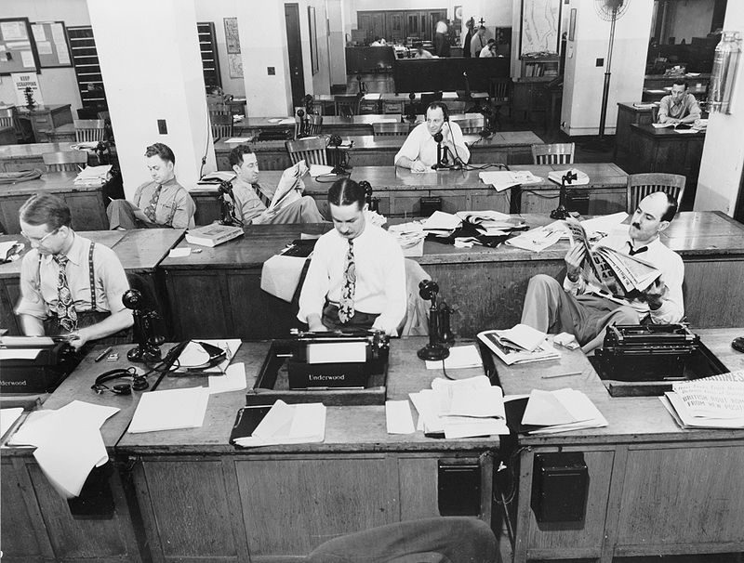
History
Goal
Fondation
Name
Ochs era
Post-war expansion
1970s-1980s
Numeric era

Slide 4
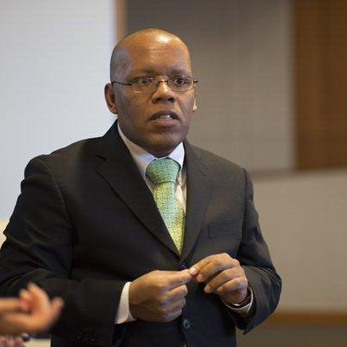
Jayson Blair plagiarism and fabrication scandal
April 2003 : similarities between an article written by Blair and an article published by San Antonio Express-News reporter Macarena Hernandez
Inquiry
May 2003 : Headline of the NYT : "Times Reporter Who Resigned Leaves Long Trail of Deception“
“A low point in the 152-year history of the newspaper.“ (NYT)

Slide 5
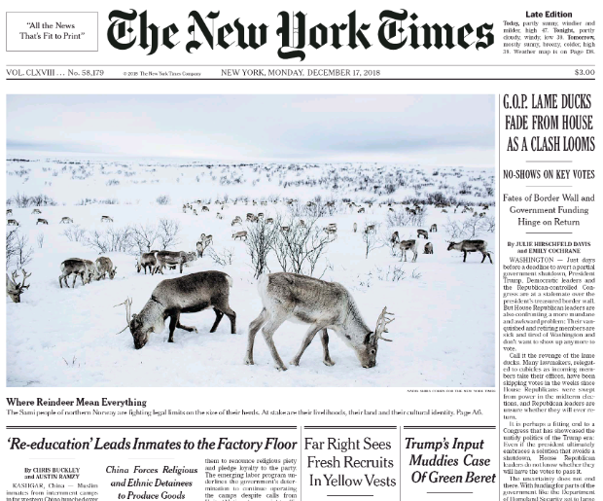
Organization and content
- First page :
slogan in the USA version
Starting immediately with articles
References to some articles in the international version
First impression : easy to read and simple design
First section :
starting from the first page presentation of the most important articles.
Section world, business, opinion, sports, culture, travel :
Presenting articles from all over the world
16 pages news paper
6 column pages
- Not a lot of ads.

Slide 6
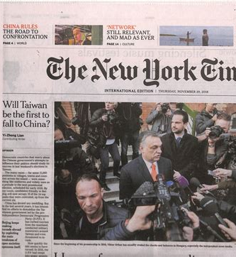
Editorial stance and readership
Often regarded as liberal → Donald Trump : « The failing New York Times »
2016 : 9.32 million daily readers
Urban and international audience
32% : 18-29 year-olds
56% : college graduates
38% : high-income earners
(Source : Pew Research)

